Slide 1


MSIN0221 Natural Language Processing | Group 5 | Project Presentation

Slide 2
Presentation Agenda
c
Overview
- Project Background
- Project Objective and Business Value
Methodology
- Data Collection and Preparation
- Model Selection, Training and Optimization
Evaluation
- Evaluation Matrix Selection
- Performance Comparison and Error Analysis
Limitations
- Model Limitations
- Suggestions
Looking Ahead
- Conclusion
- Recommendations
Overview | Methodology | Evaluation | Limitations | Looking Ahead
1

Slide 3

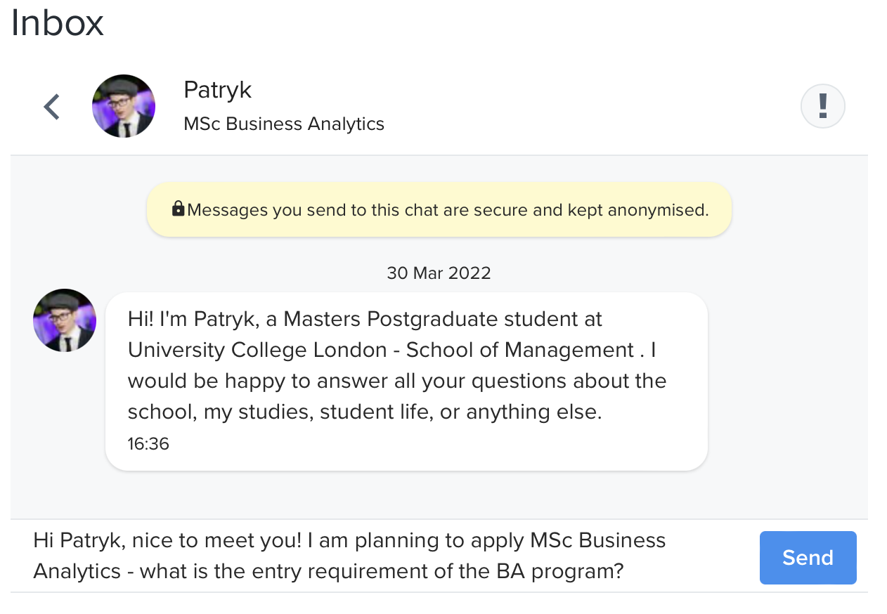



c
Overview
Project Background
Project Objective and Business Value
A snapshot of the SoM chatbot. There is the default greeting from the student ambassador to start the conversation and prospective students can ask whatever questions they have for the program, student life or school.
Build a Q&A model that can respond to general enquiries regarding two master programmes - MSc Finance and MSc Business Analytics.
[Save Cost] Around 70% of the questions received are generic program info related questions, £1,370.25 of the operating costs will be saved on answering questions per year.
[Save Time] Assume it takes one minute to answer one question on average, a total of 87.5 hours will be saved on answering questions per year.
3 Transformers have been selected to train the Q&A chatbot:
BERT-base, BERT-large, Electra-large.
Overview | Methodology | Evaluation | Limitations | Looking Ahead
2

Slide 4



Methodology
Data Collection and Preparation
Model Selection
 | BERT-base | BERT-large | ELECTRA-base
# Parameter | 110 millions | 336 millions | 110 millions
Dataset | SQuAD 2.0 | SQuAD 2.0 | SQuAD 2.0
Cased/Uncased | Cased | Uncased | -
Tokenization | Character-level | Word-level | Character-level
Project Information - Scraped the text from UCL SOM website using Beautiful Soup.
Format Cleaning
Corpus Splitting
Answer Matching
Answer Indexing
All of them are open-source and publicly available in the AI community Hugging Face
Question and Answer Sets
- 1,500+ questions for MSc Finance
- 500+ questions for MSc Business Analytics
Overview | Methodology | Evaluation | Limitations | Looking Ahead
3

Slide 5

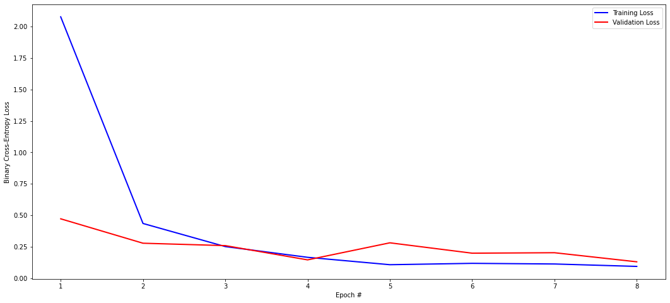
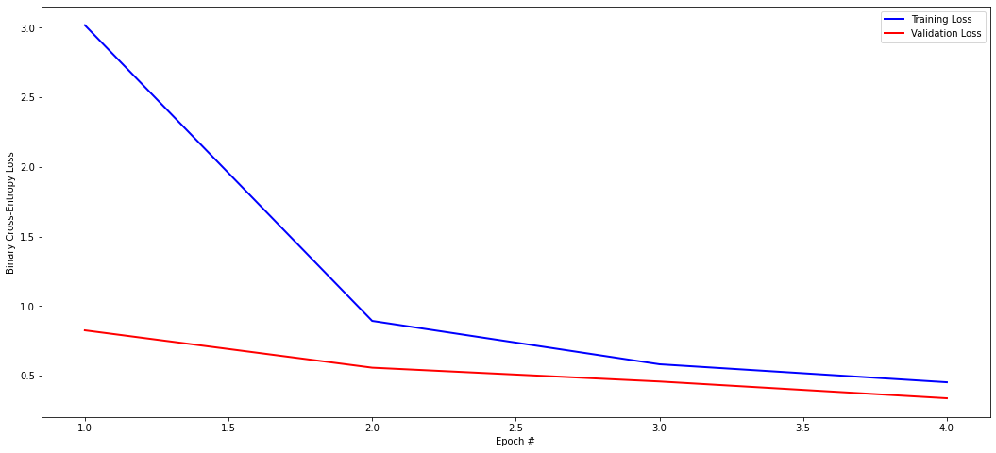
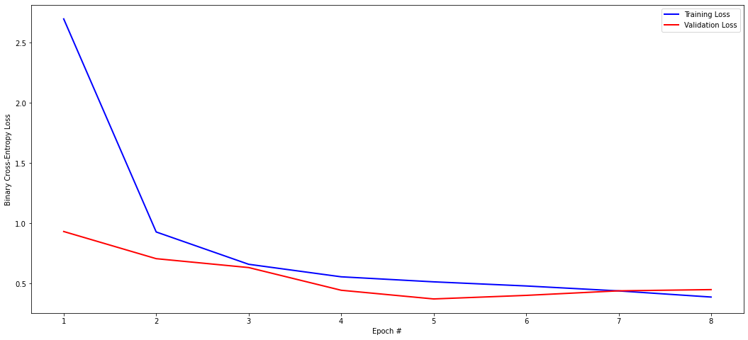
Methodology
Model Training
Model Optimization
 | BERT-base | BERT-large | ELECTRA-base
1st Training | batch_size = 8 epoch = 8 | epoch = 8 | batch_size = 8 epoch = 4
Batch Size and Epoch Combinations - BERT-base and ELECTRA-base models
Pre-trained Open Source Trainer -
BERT-large model
 | BERT-base | BERT-large | ELECTRA-base
1st round optimization | batch size = 16 epoch = 4 | google/bert_uncased_L-2_H-128_A-2 | batch size = 16 epoch = 4
2nd round optimization | batch_size = 32 epoch = 4 | google/bert_uncased_L-4_H-512_A-8 | batch size = 16 epoch = 8
3rd round optimization | batch_size = 16 epoch = 8 | google/bert_uncased_L-12_H-768_A-12 | batch size = 32 epoch = 13
Figure 1: BERT-base model: training and validation loss graph
Figure 3: Electra-base model: training and validation loss graph
Figure 2: BERT-large model: training and validation loss graph
Overview | Methodology | Evaluation | Limitations | Looking Ahead
4

Slide 6
Evaluation
Evaluation Metric Selection
Performance Comparison
High
High
0.41
0.40
 | F1 Score for Word-Overlapping
Model | 1st training | 1st fine-tuning | 2nd fine-tuning | 3rd fine-tuning
BERT-base | 0.26 | 0.34 | 0.23 | 0.27
BERT-large | 0.44 | 0.47 | 0.46 | 0.44
ELECTRA-base | 0.22 | 0.23 | 0.23 | 0.23
Medium
Medium
Accuracy Score for Exact Answer
Accuracy Score for Manual Evaluation
0.26
0.28
1
0.0098
0.0049
Low
Low
Bert-base
Bert Large
Electra-base
Bert-base
Bert Large
Electra-base
Model
Model
 |  | F1 Score for Word-Overlapping
Model | Fine-tuning Hyperparameter | Validation Set | Test Set
BERT-large | google/bert_uncased_L-2_H-128_A-2 | 0.47 | 0.39
BERT-large | google/bert_uncased_L-4_H-512_A-8 | 0.46 | 0.39
We decided that F1 score is the most appropriate evaluation matrix for this project.
High
0.44
Medium
FI Score for word overlapping
0.26
0.22
Low
Bert-base
Bert Large
Electra-base
Model
Overview | Methodology | Evaluation | Limitations | Looking Ahead
5

Slide 7


Evaluation
Error Analysis
Example of Wrong answers
1
BERT-Base
The model cannot understand the association of words separated by commas in a sentence.
The question is too long for the model to understand.
What is the desired academic background for MSc Finance?
2
BERT-Large
The model fails to understand the question because the keyword in Question is not found in the context.
The question is too long for the model to understand.
The model cannot understand the association of words separated by commas in a sentence.
thereof.
[Right Answer] economics, finance, mathematics, mathematical economics, econometrics, economic theory, statistics, engineering, or any combination of thereof.
3
Electra-Base
The model only returns part of the answer because it is closer to the keyword.
The question is too long for the model to understand.
Overview | Methodology | Evaluation | Limitations | Looking Ahead
6

Slide 8

Limitations
Model Limitations and Suggestions
Limited
Dataset Size
Computational
Resources
Model
Limitations
Early Stopping
for Epoch
Overview | Methodology | Evaluation | Limitations | Looking Ahead
7

Slide 9



Looking Ahead
Conclusion and Recommendations
Expand Application
Smarter Responses
Restructure webpage
Overview | Methodology | Evaluation | Limitations | Looking Ahead
8

